Slide 1
Pix2code：Generating Code from a Graphical User Interface Screenshot
Tony Beltramelli
Uizard Technologies
Copenhagen, Denmark
CoRR 201705

Slide 2
The example given
https://emilwallner.github.io/bootstrap/pred_1/
https://emilwallner.github.io/bootstrap/real_1/

Slide 3
Introduction
A novel approach based on Convolutional and Recurrent Neural Networks allowing the generation of computer tokens from a single GUI screenshot as input.

Slide 4
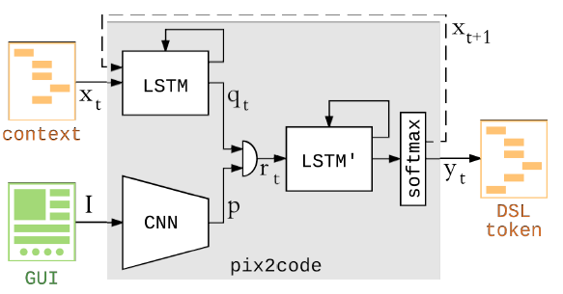
Conceptional Graph

Slide 5

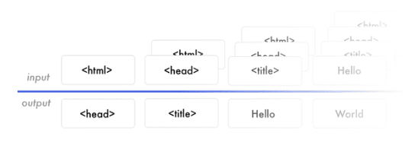
Dataset of input and output

Slide 6
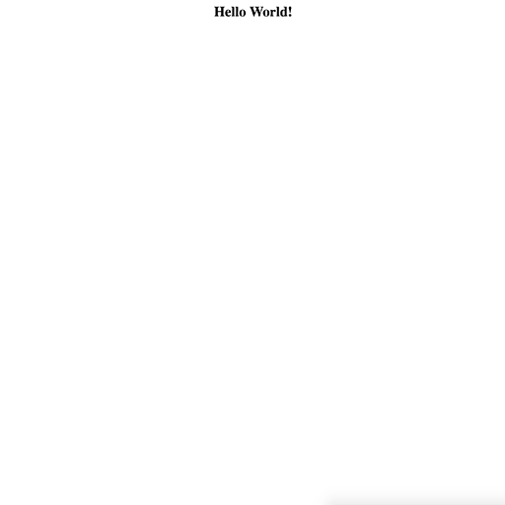
Demo1—Hello World!
Input: Output:
<START>
<HTML>Hello World!</HTML>
<END>

Slide 7

Dataset of Demo1
<START>
<START>
<HTML>Hello World!</HTML>
<HTML>Hello World!</HTML>
<END>

Slide 8
Matrix expression of Dataset
1. Img expression --> 224*224*3 matrix
2. HTML word expression --> one hot spot
2.1 <START> --> (1,0,0)
2.2 <HTML>Hello World!</HTML> -->(0,1,0)
2.3 <END> --> (0,0,1)
3. HTML paragraph expression --> max_len = 3
3.1 <START> --> ((0,0,0),(0,0,0),(1,0,0))
3.2 <START> <HTML>Hello World!</HTML>
--> ((0,0,0),(1,0,0),(0,1,0))

Slide 9
2 training_datasets
224*224*3 img
1st
2nd
0, 1, 0
0, 0, 0
0, 0, 0
1, 0, 0
224*224*3 img
0, 0, 1
0, 0, 0
1, 0, 0
0, 1, 0

Slide 10
Network Architecture of Hello World
FC
5
2 imgs
VGG16
Repeat
Vector
5
3-softmax
5
224*224*3
1000
3*5
3*10
LSTM
5
5
2 HTML
LSTM
3*3
3*5

Slide 11

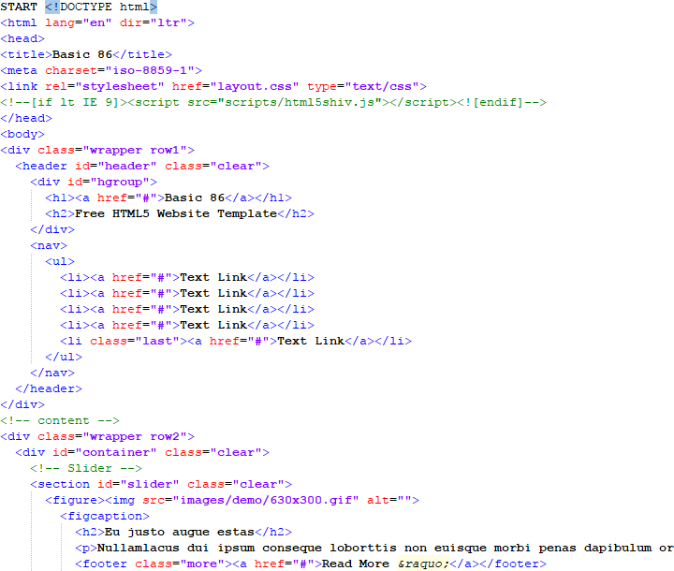
Demo2—HTML(Dataset)
Input: Output:
<START>
<HTML>Hello World!</HTML>
<END>

Slide 12

Dataset Processing
HTML pictures(299*299*3):
HTML scripts(tokenizer):
<html lang="en"> 1. <html
<head> ---> 2. lang=“en”>\n<head>\n<title>Basic
<title>Basic 86</title> 3. 86</title></head>
</head>

Slide 13
training_datasets
8*8*1536 img
1st
2nd
2(one-hot)
0,0,0,…..0,0,1
8*8*1536 img
3(one-hot)
0,0,0,…..0,1,2

Slide 14
Network Architecture of HTML
flatten
fc
128
5 imgs
Inception Resnet V2
Repeat
Vector
128
128
299*299*3
8*8*1536
100*128
98304
128
436-softmax
LSTM
512
5 HTML
Tokenizer
Embedding
LSTM
100*256
100
100*200
100*256
Repeat
Vector
LSTM
TimeDistributed Dense
100*256
100*128

Slide 15
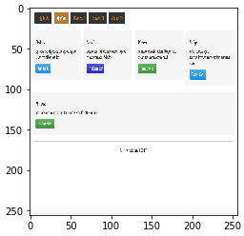
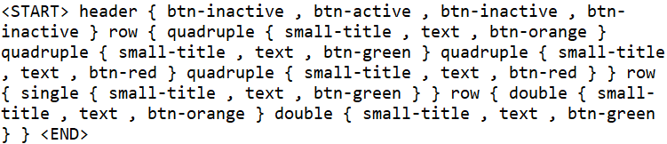
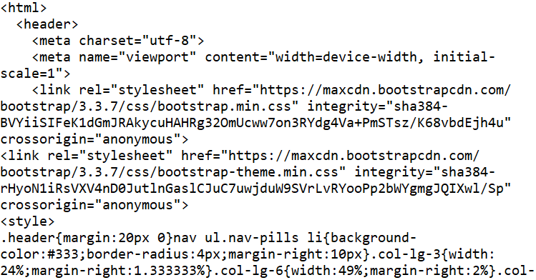
Demo3—Bootstrap
output
compile

Slide 16
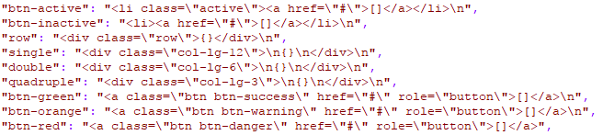
Compile the DOM structure

Slide 17
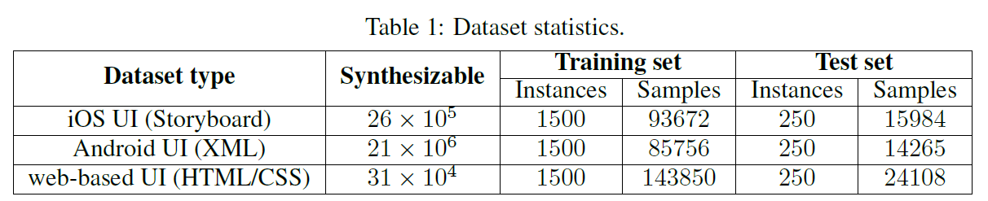
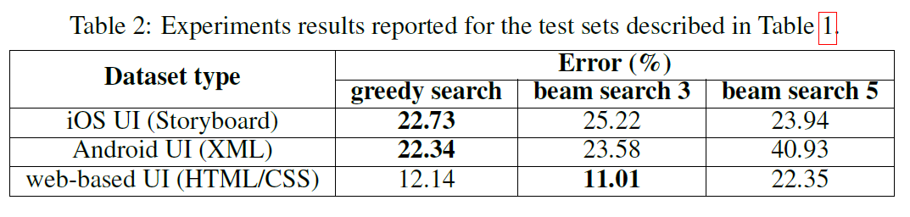
Experiment datasets and results

Slide 18
My Question and your answers

